Slide 1

Machine Learning Project
Chronic Kidney Disease Prediction
A.VINAY TEJA | CSE(AI&ML) | 2203A52223
Under the Guidance of
~Ramesh sir

Slide 2
Agenda
What is Machine learning?
Types of Machine learning
Introduction
Procedure
Perceptron & SVM
KNN
Applying Bootstrapping method
conclusion
Summary

Slide 3

What is machine learning?

Slide 4
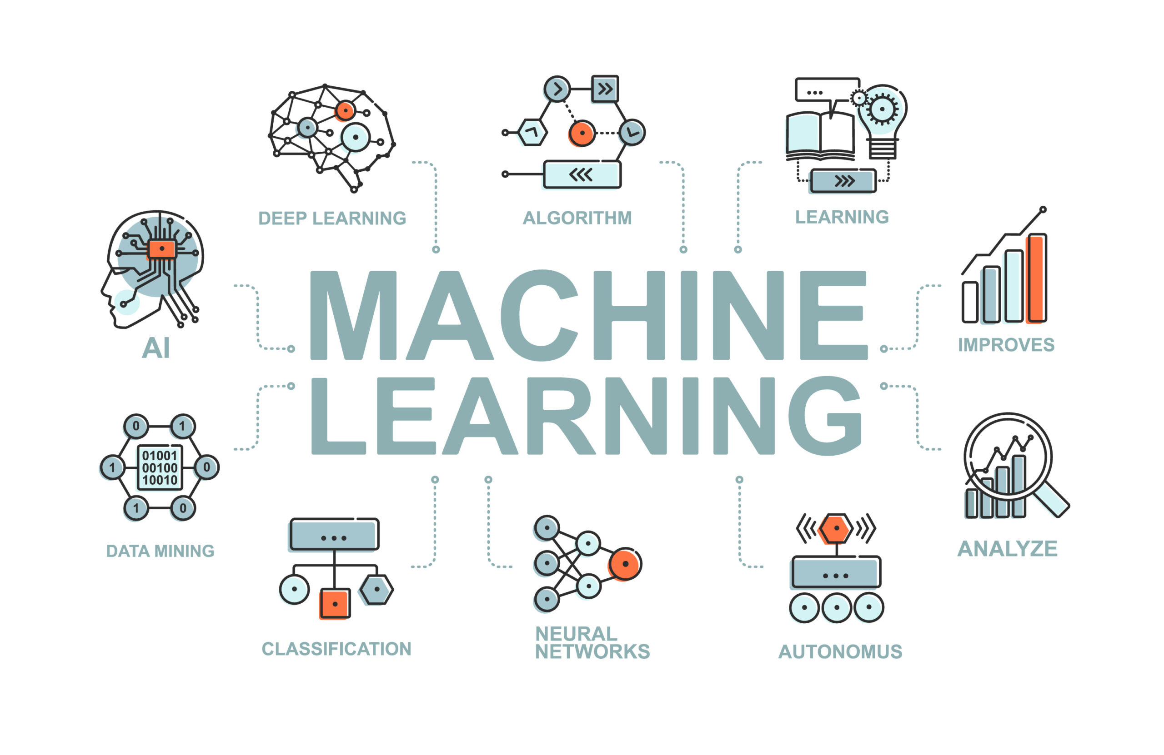

Slide 5
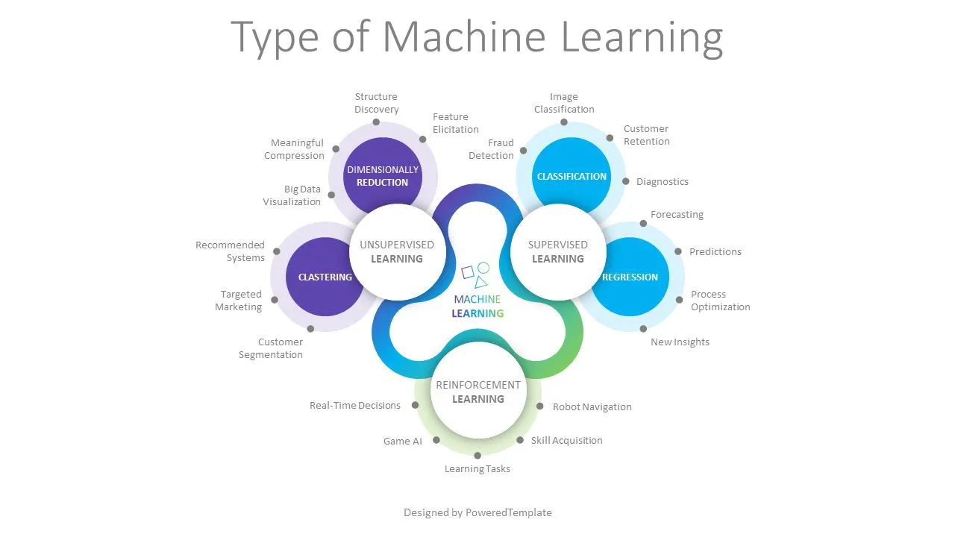


Source:Google

Slide 6
INTRODUCTION
Chronic Kidney Disease (CKD) is a medical condition characterized by the gradual loss of kidney function over an extended period, typically spanning months to years. This condition is a significant global health concern, affecting millions of people worldwide.
CAUSES: There are various underlying causes of CKD, with the most common being diabetes and hypertension (high blood pressure). Other causes include autoimmune diseases, genetic disorders, infections, kidney stones, and certain medications.
IMPACT: CKD can significantly affect a person's quality of life, as it may require dietary restrictions, medication management, and frequent medical appointments. It can also lead to emotional and psychological challenges due to the chronic nature of the disease.

Slide 7
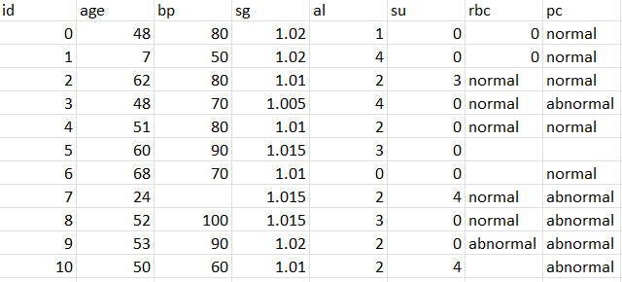
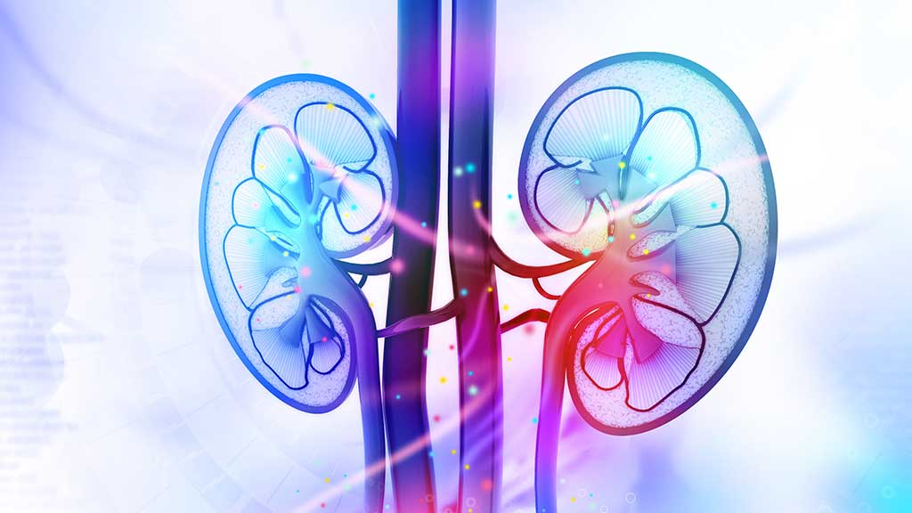
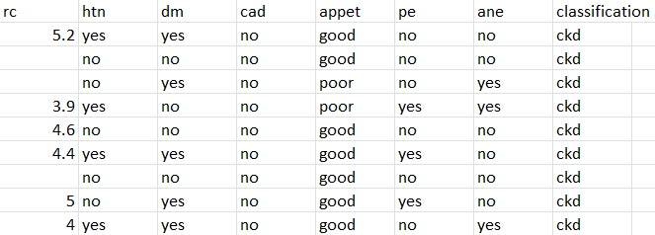
|Chronic Kidney Disease Prediction

Slide 8
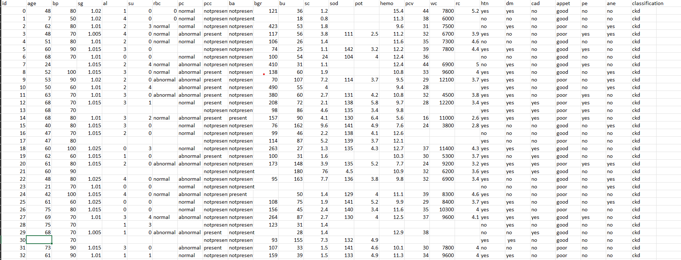
Data set :

Slide 9

We do
Logistic Regression
Perceptron learning (using libraries)
Support vector Machine(SVM)(using libraries)
KNN (using libraries)
Bootstrapping for all models

Slide 10
| Procedure
1
Preprocessing
Read the data set and identify the Null values if there are any null values fill them with zeroes/fill with mean value/eliminate the column
2
Identify Features and target variables
Identify the features and target variables
3
Training and Testing
Split the data into training and testing (more data for training)
4
scaling
Finding Accuracy

Slide 11
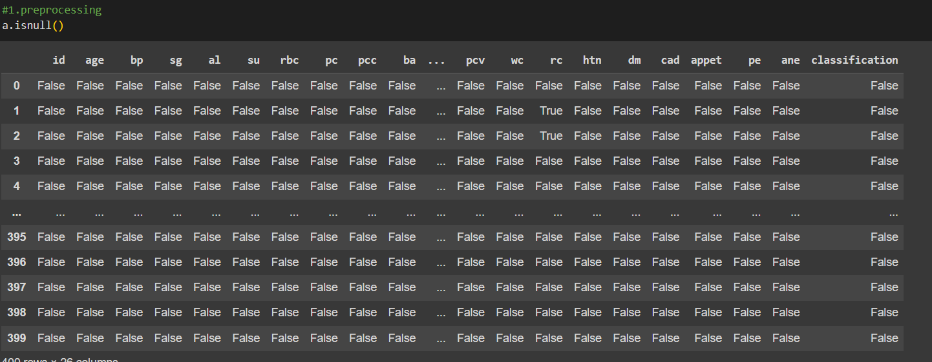
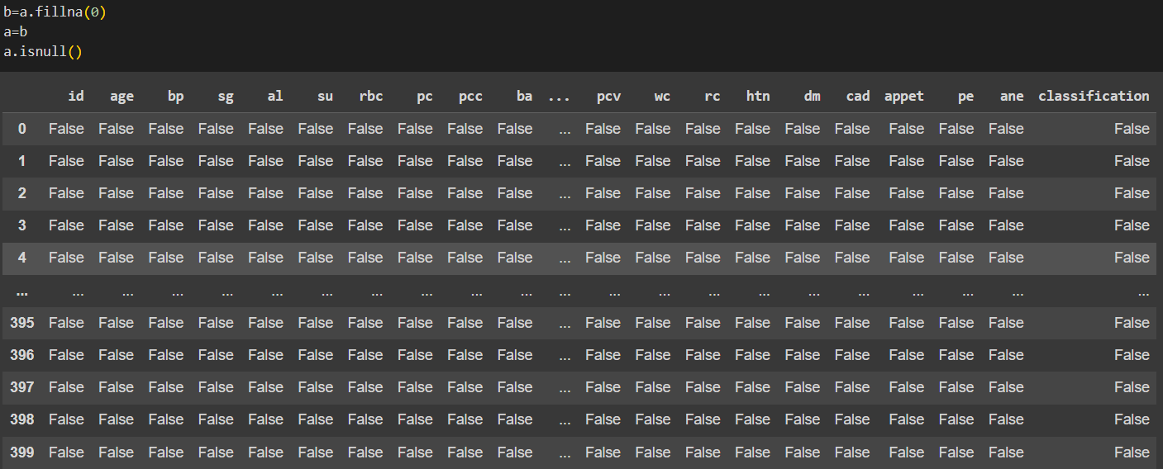


| Preprocessing
Find null values and replace with 0’s /sum of the column

Slide 12

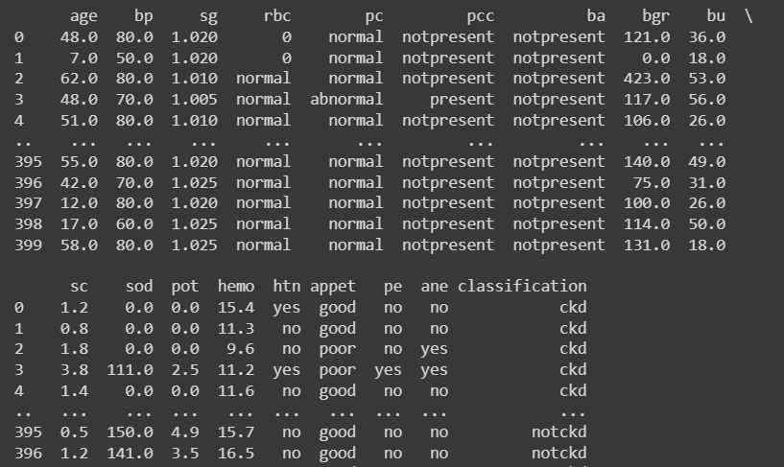
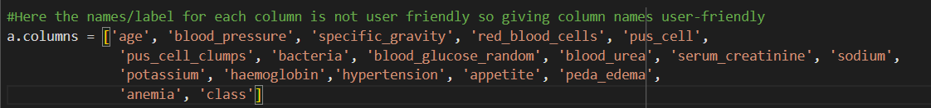


Attributes
Age
Blood Pressure
Specific Gravity
Red Blood Cells
Pus Cell
Pus Cell Clumps
Bacteria
Blood Glucose Random
Blood Urea
Serum Creatinine
Sodium
Potassium
Hemoglobin
Hypertension
Appetite
Pedal Edema
Anemia
Class

Slide 13
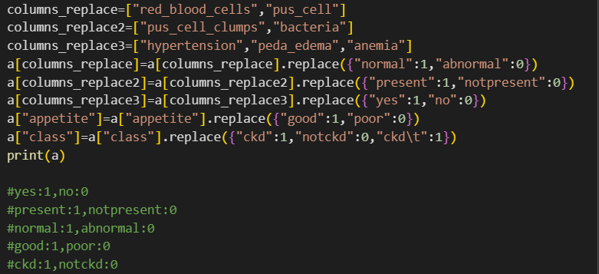



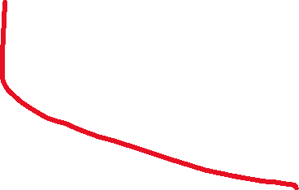
Convert all textual data to numerical data

Slide 14
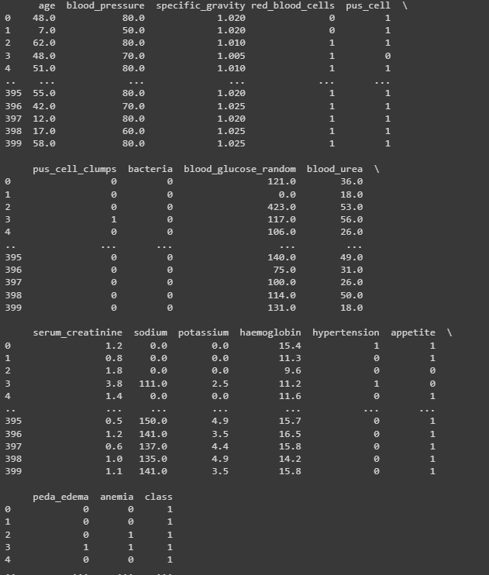
String data is converted to numerical data

Slide 15
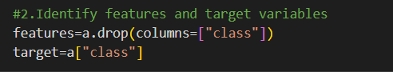

| Identify Features and target variables

Slide 16
| Training and Testing
split the data into training and testing
Training Set: This portion of the dataset is used to train the machine learning model. It's the part of the data that the model uses to learn patterns, relationships, and associations between the input features and the target variable. The training set is usually larger than the test set, often containing around 70-80% of the data.
2.Test Set: This subset is kept separate from the training data and is used to evaluate the model's performance and generalization. The model has never seen the data in the test set during training. It helps you estimate how well your model will perform on new, unseen data. Typically, the test set contains around 20-30% of the data, but, again, this can vary.

Slide 17
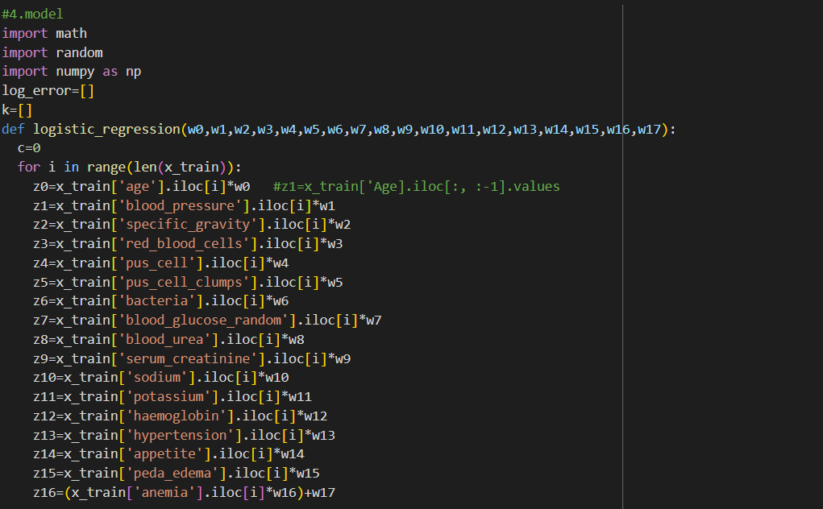
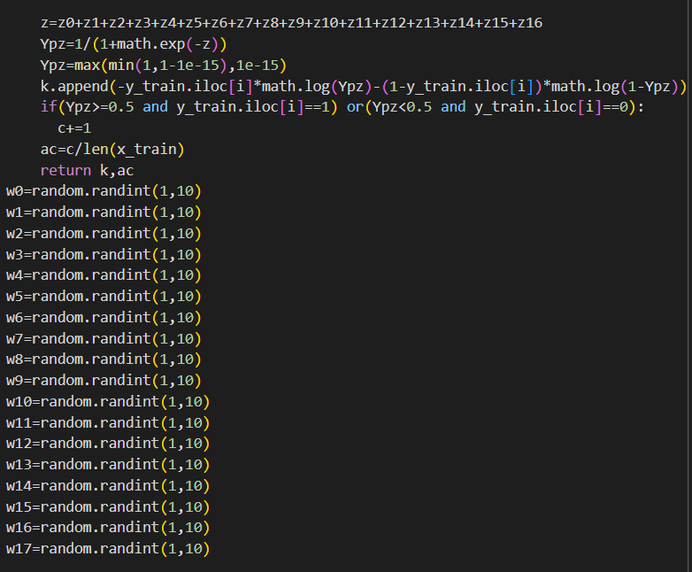
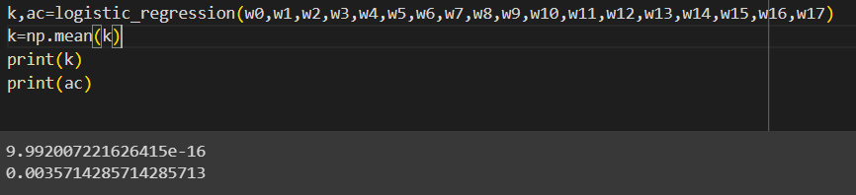
| Accuracy

Slide 18
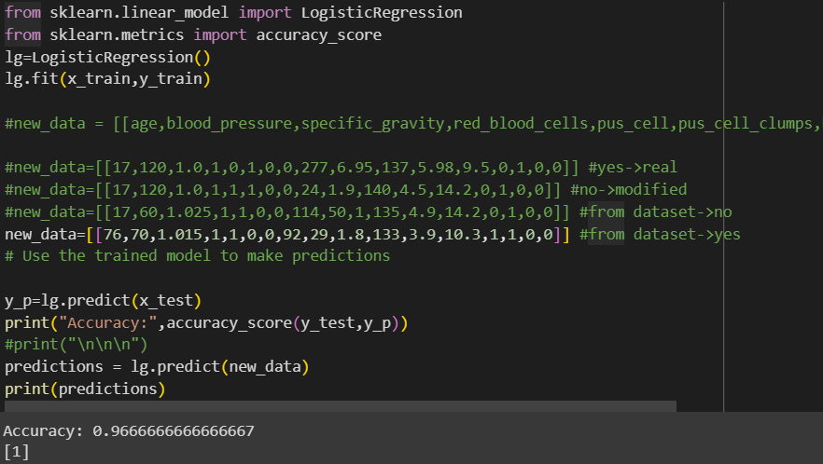
| Final Result
NOTE: Here [1] indicates that the data we given indicates the person has Chronic Kidney Disease (CKD)

Slide 19
Perceptron
&
support vector Machine(SVM)

Slide 20
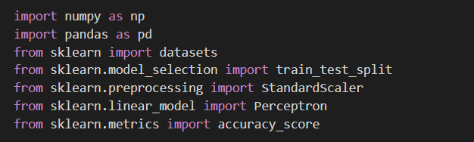
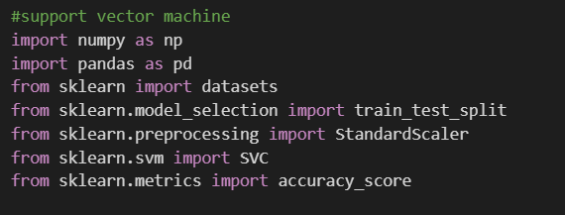
| Procedure
Import necessary librarires
Do the same as logistic regression upto training and testing
Using libraries find the accuracy for both the models
perceptron
SVM

Slide 21
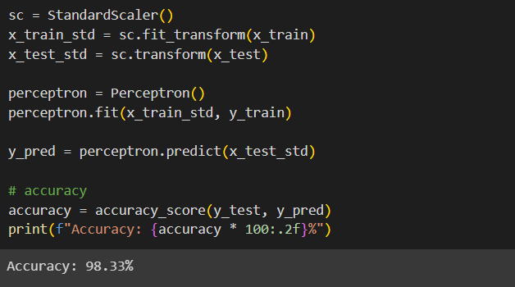
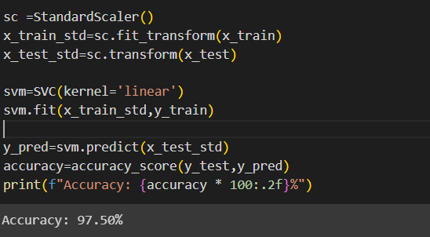

perceptron
SVM

Slide 22
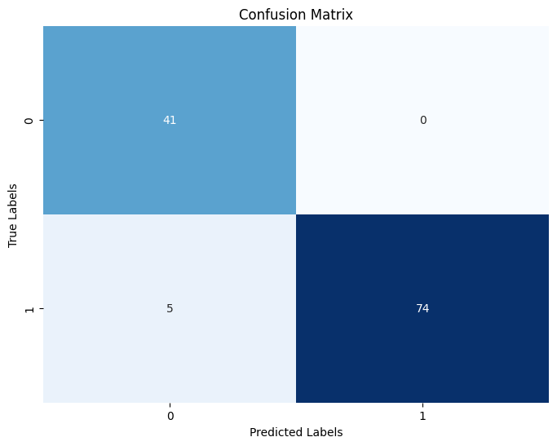
Confusion Matrix:
Logistic Regression
TP
FP
FN
FP

Slide 23


Confusion Matrix:
Perceptron
SVM

Slide 24
K-Nearest Neighbors (KNN)

Slide 25
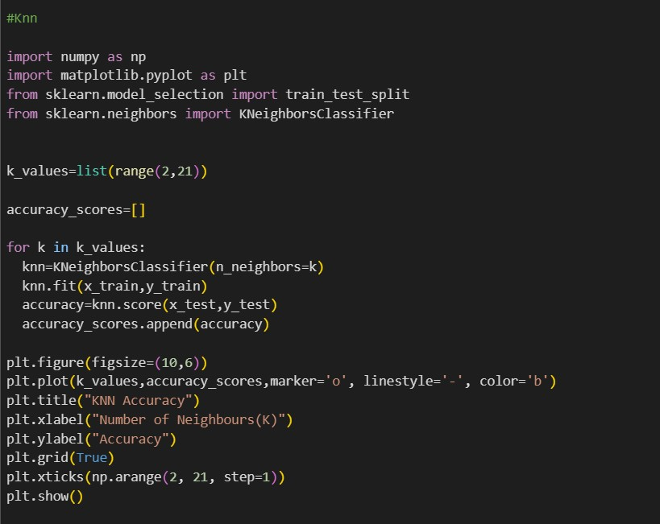
K-NEAREST NEIGHBORS (KNN):

Slide 26
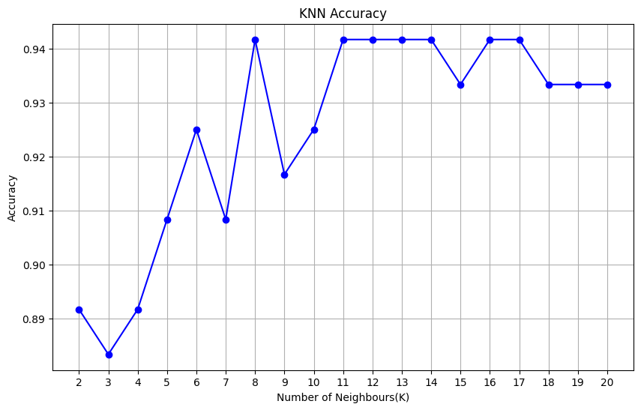
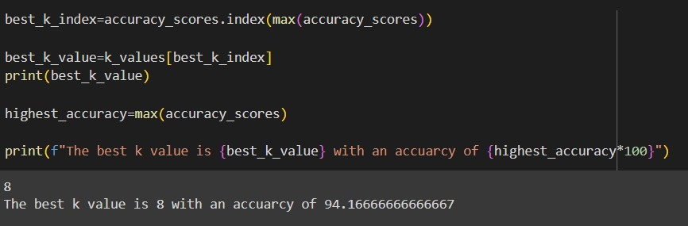
K-NEAREST NEIGHBORS (KNN):

Slide 27
BOOTSTRAPPING
with
Logistic Regression, Perceptron Learning, Support vector Machine (SVM), K-Nearest Neighbors (KNN)

Slide 28
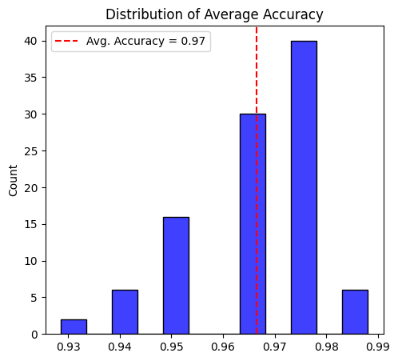
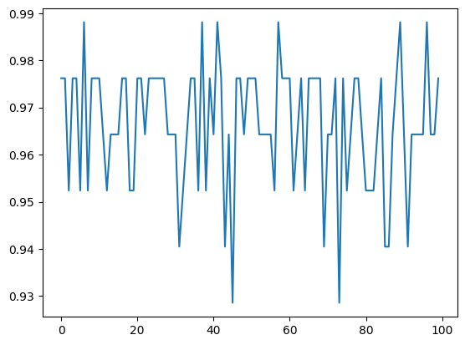
BOOTSTRAPPING with Logistic Regression:

Slide 29
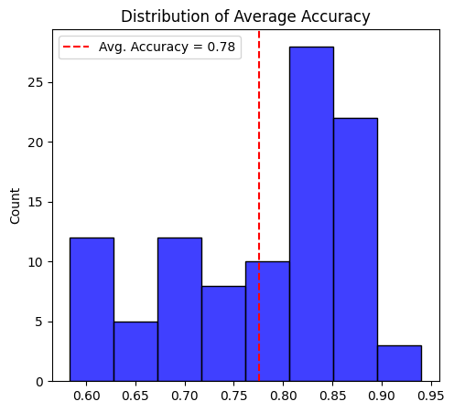
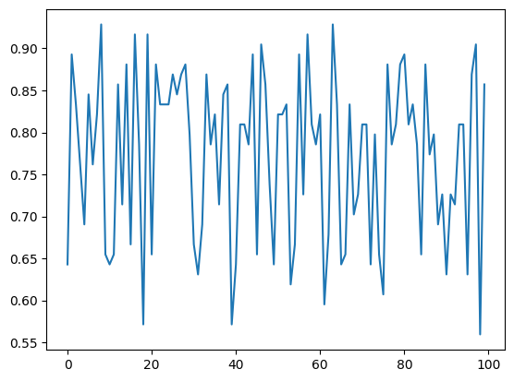
BOOTSTRAPPING with Perceptron Learning:

Slide 30
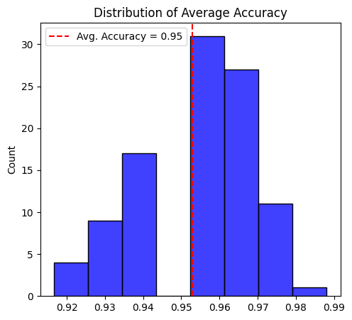
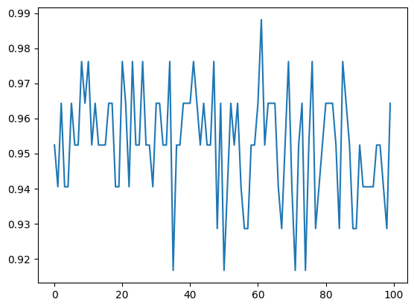
BOOTSTRAPPING with support vector Machine (SVM):

Slide 31
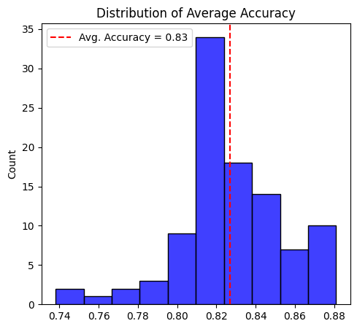
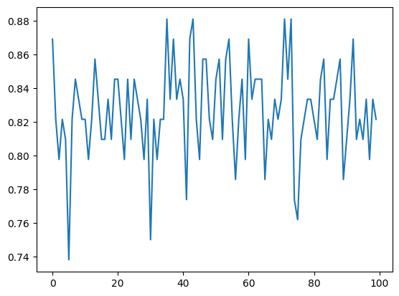
BOOTSTRAPPING with KNN:

Slide 32
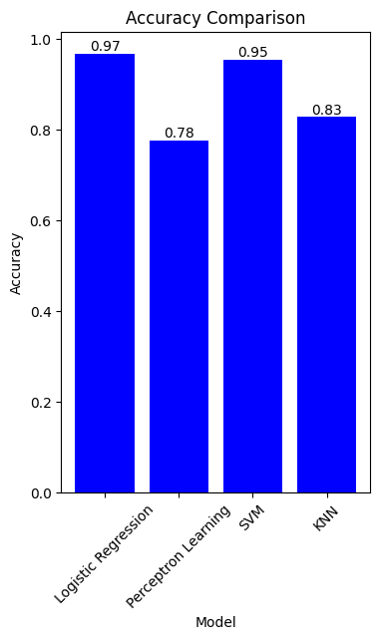
Models vs iterations:

Slide 33
Conclusion
Logistic regression stands out of all models with an accuracy of 97% and perceptron Learning is least performed with an accuracy of 78% and SVM with 95% and KNN with 83%. So Logistic regression performs well in finding out Chronic Kidney Disease (CKD)

Slide 34
SUMMARY
This model comes under supervised learning because it has labelled data.
The target variable has categorical data
So,it comes under classification
Under classification we can do logistic regression, perceptron learning,support vector machine,K-Nearest Neighbors (KNN)
By Training & Testing data then,We find Accuracy.
We apply Bootstrapping method to all the models in order to find the performance and stability.
Finally, we conclude that from all models Logistic Regression is concluded as the best model with an accuracy of 97%.

Slide 35
Thankyou

